Slide 1
EduOS Hybrid Operating System Simulator
Course : Operating system assignment 1
Module code : 351 CS 2104
Name : Precious Mpita

Slide 2
Abstract
EduOS is a hybrid operating system simulator developed using Python and C.
The project demonstrates :
CPU scheduling, threading, synchronization, IPC, race conditions, deadlock handling, and process management.
Python was used for scheduling algorithms, visualization, and reporting, while C was used for low-level system simulations.

Slide 3
Design Decisions
1. PCB structure stores PID, priority, burst time , arrival time and state.
2. POSIX threads were used for concurrency.
3. Shared memory was selected for fast IPC.
4. Mutex locks prevent race conditions.
5. Python visualization simplified scheduling analysis.

Slide 4
Syllabus Mapping Table
Implemented | Folders created
CPU scheduling | Python_scheduler.py
PCB Management | pcb.py
Threading | thread_manager.c
IPC | ipc_module.c
Synchronization | fixed_demo.c
Deadlock | Deadlock_demo.c

Slide 5
Scheduling Results & Analysis
FCFS, SJF, Priority, and Round Robin were implemented.
SJF produced the lowest waiting time because shorter jobs execute first.
Round Robin improved fairness for multitasking systems.

Slide 6
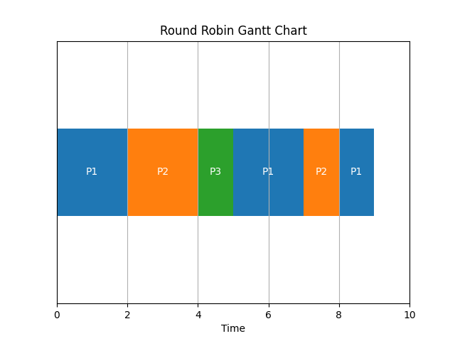
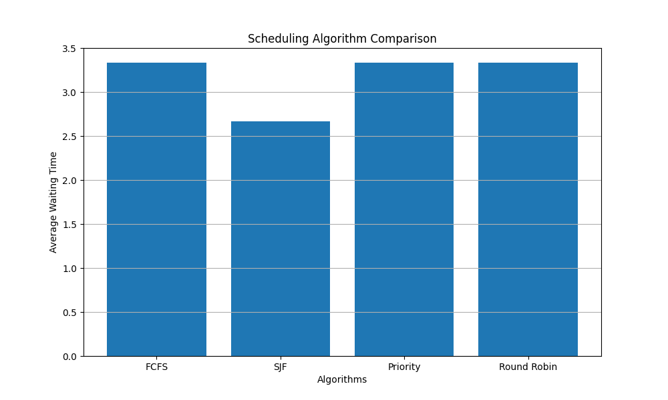
Analysis Graphs
Gantt chart
Comparison chart

Slide 7
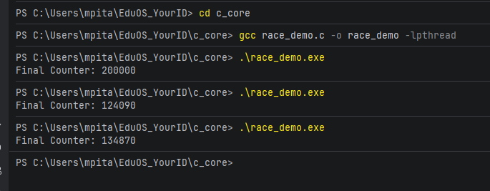
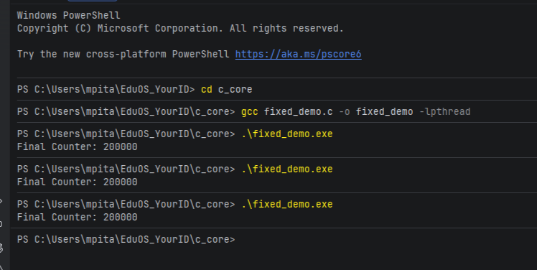
Race condition
Make race
Fixe race

Slide 8
Virtual machine
A virtual machine is a software based computer system managed by a hypervisor.
EduOS demonstrates related concepts such as process isolation , multitasking, and resource sharing using PCB management and scheduling algorithms

Slide 9
Threading Issues Encountered
Race conditions occurred when multiple threads updated shared data simultaneously.
A mutex lock fixed the issue and ensured correct synchronization and protected critical sections.

Slide 10
C vs Python: Lessons Learned
Python simplified scheduling logic and visualization using high-level structures.
C provided low-level control and better understanding of memory, threading, and IPC.
Combining both languages demonstrated hybrid system integration using controller.
Learned concurrency concepts
Integration between python and c

Slide 11
Challenges & Solutions
1. CSV parsing bugs were fixed using DictReader.
2. GCC setup issues were solved through MinGW path configuration.
3. Shared memory compatibility problems were solved using Windows APIs.
4. Thread synchronization bugs were solved using mutex locks.
Indentation errors were solved using proper indentation or command(ctrl + Alt + L).
Wrong or missing path directory solved by installing required package and imports (matplotlib , tabulate)

Slide 12
GitHub Summary
The repository contains:
Python scheduling modules
C core simulation files
IPC demos
Project includes: charts, screenshots, README , documentation and source code.
Git was used for version control with meaningful commits tracking each step throughout the project.

Slide 13
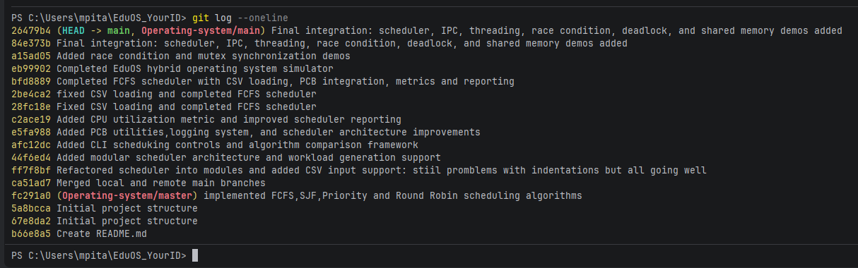
Commits (git log –oneline)

Slide 14
Conclusion
EduOS successfully demonstrates:
scheduling, synchronization, IPC, threading, deadlock handling, and process management using both Python and C.

